Slide 1
Introduction to Wireless Sensor Networks
Node and WSN network architectures

Slide 2
Group work (low power radio chips)
Find key radio parameters of the chip.
Find a block diagram of the chip (can you find also RF and BB parts from it?)
What software is provided and what you need to make yourself?
Make a short PowerPoint presentation which you can show to the group.
Notes:
Group 1 Atmel
Group 2 ST microelectronics
Group 3 Texas Instruments
Group 4 Ble112

Slide 3
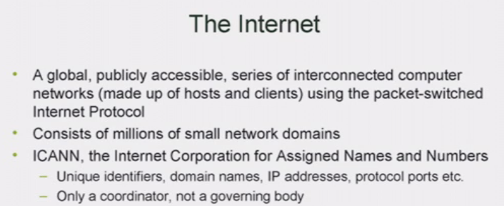
About exercises and homeworks
Explain shortly how internet works
Compare TCP/IP protocol stack and 6LoWPAN protocol stack. What are the differences?
What 6LoWPAN header compression actually compresses?
Why IPv6 neighbor discovery does not work for 6LoWPAN?

Slide 4
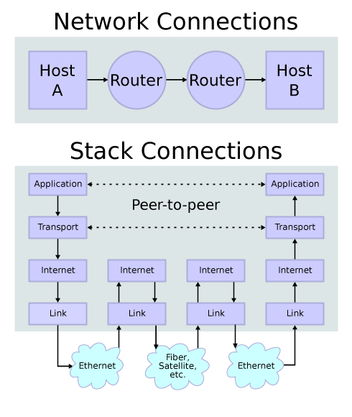
Internet Architecture
Image source: (Wikipeida) GFDL
v6.12.2009
6LoWPAN: The Wireless Embedded Internet, Shelby & Bormann

Slide 5
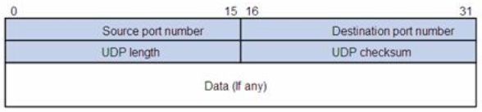
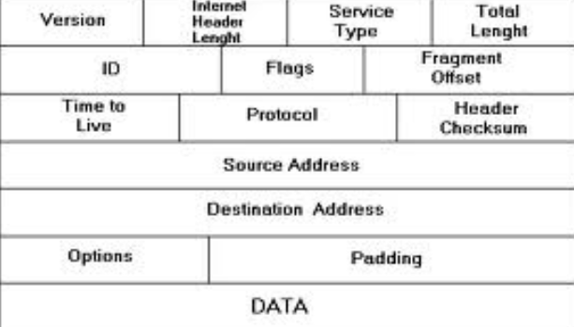

Slide 6
Excercise
Read standard IEEE 802.15.4-2006, chapter 5 and answer:
Explain the difference between star and peer to peer topologies. What is then mesh topology and who specifies it?
What are the tasks of PHY and MAC
There are 3 data transfer transactions. What they are? Explain shortly the operation of each data transfer mechanism.
When to use beacon and when non-beacon access?
Notes:
Star is similar to Wifi base station where all communication of devices goes through the base station. Peer to peer is a structure where all nodes can communicate with each other.
Mesh is the one where nodes are forwarding their messages through other nodes towards a destination. IEEE 802.15.4 does not specify mesh, peer to peer nor star topology formation. Instead that is left as an upper layers task. Either Zigbee standard or 6LoWPAN approach can be used to make a network.
PHY
activation and deactivation of the radio transceiver,
ED (Enegy Detection)
LQI (Link Quality Indication)
channel selection,
clear channel assessment (CCA),
and transmitting as well as receiving packets across the physical medium
MAC
-beacon management,
channel access,
GTS management,
Frame validation,
acknowledged frame delivery,
association, and disassociation.
Beacon access when there is lot’s of traffic in the network. (Slotted Aloha and Guaranteed time slot mechanisms)
Non-beacon access when node’s don’t need to listen but just send their sensor values time to time.

Slide 7
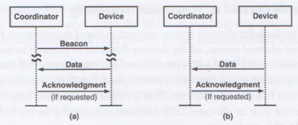
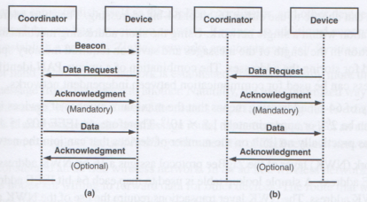
Notes:
Upper = Device => Coordinator
Lower = Coordinator => Device
Left side = Beacon enabled network
Right side = Non-Beacon network

Slide 8
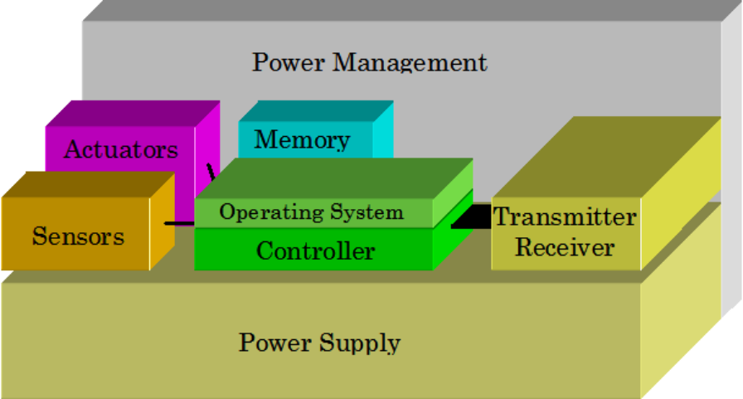
Device Architecture
Microcontroller and program code
Power supply
  Power management
  Renewable energy?
Memory (RAM, FLASH)
Sensors
Actuators
Communication
Input/output
Part of a larger system?
  TI 6LoWPAN Kit
v4.3.2010
6LoWPAN: The Wireless Embedded Internet, Shelby & Bormann

Slide 9
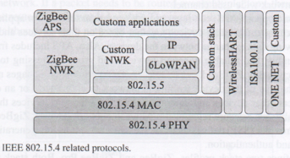
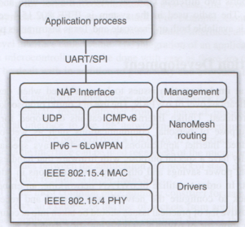
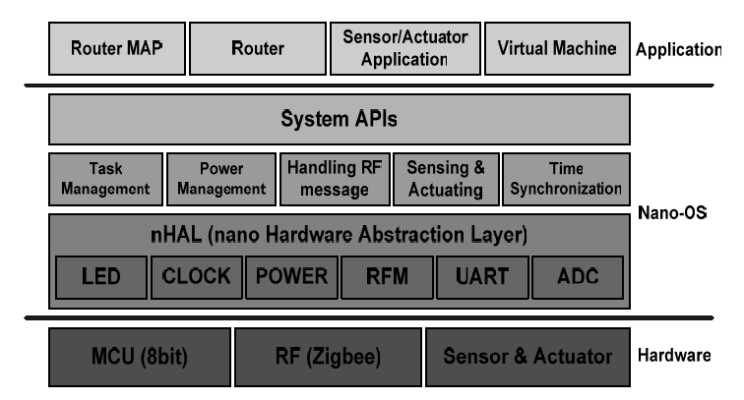
Program code
Notes:
QUESTION? HOW CAN YOU EXECUTE 2 TASKS AT THE SAME TIME WITH ONE CPU?
I.E. HOW SCHEDULING OPERATES?
Which of those 3 figures best describes a node software architecture?

Slide 10
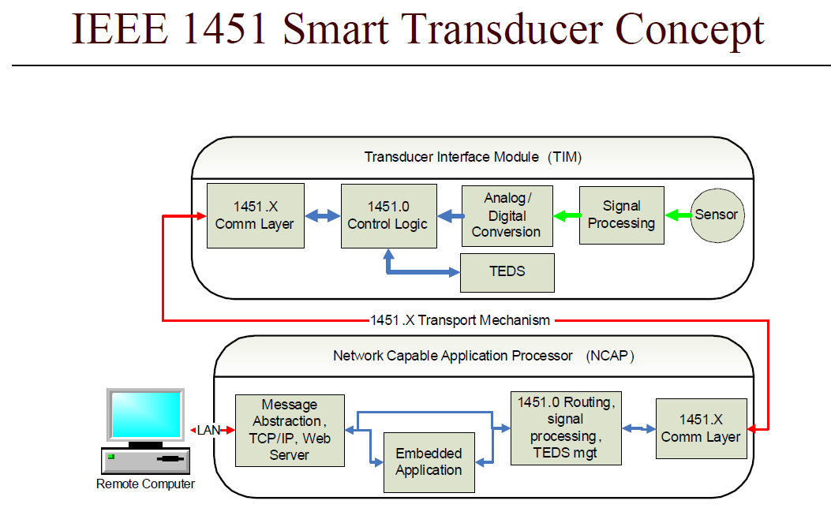
Notes:
TEDS = Transducer Electronic Data Sheet = The TEDS is a memory device attached to the transducer, which stores transducer identification, calibration, correction data, and manufacturer-related information.
Is this too complicated for WSN?

Slide 11
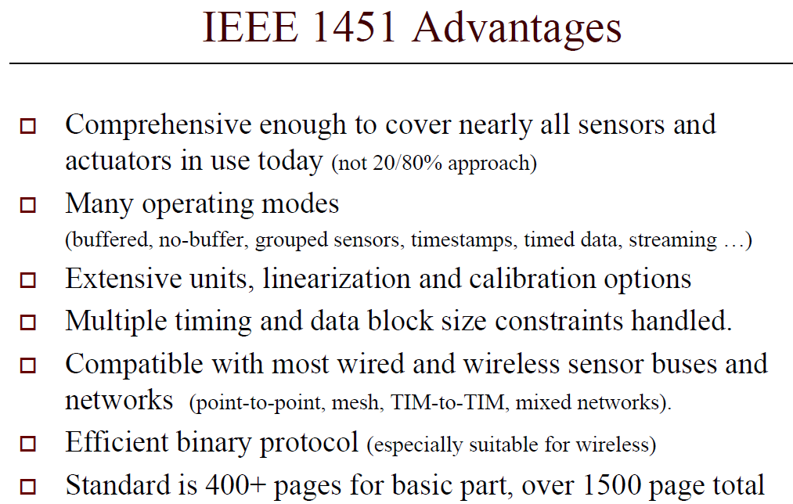

Slide 12
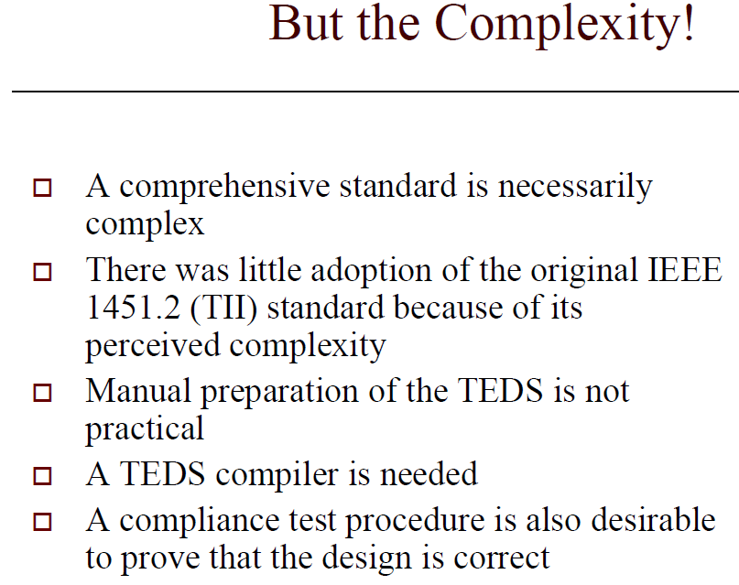

Slide 13
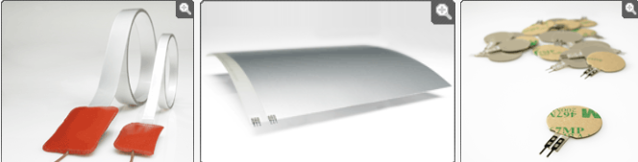
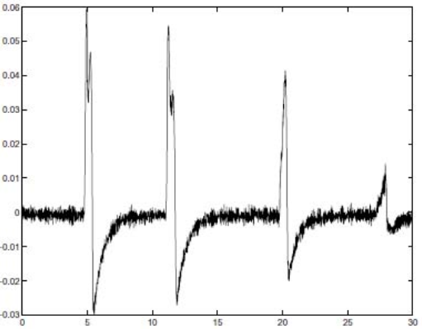
Notes:
As WSN nodes must be cheap:
Sensors can not cost much
Sensor connection to CPU A/D converter is needed
Possibly also some sensor signal processing is needed.

Slide 14
Some videos on sensors
TI LMP91200

Slide 15
Battery examples
Energy per volume (Joule per cubic centimeter):
Primary batteries
Chemistry | Zinc-air | Lithium | Alkaline
Energy (J/cm³) | 3780 | 2880 | 1200
Secondary batteries
Chemistry | Lithium | NiMHd | NiCd
Energy (J/cm³) | 1080 | 860 | 650
SS 05
Ad hoc & sensor networks - Ch 2: Single node architecture

Slide 16
Excercise
Read chapter 3 of energy harvesting document (Optima)
Alkaline battery energy capacity is 1200 J/cm3 (=Ws/cm3). Table 1 gives average WSN node power consumption. How long can 1 cm3 battery power the lowest consumption node?
Why batteries and fuel cells are not seen as suitable power sources for WSNs (according the document)
Document introduces electromagnetic radiation, thermal and mechanical energy harvesting methods. Find good and not so good properties of those harvesting methods.
Notes:
1200 J / 2,8 mW = 428571 s => 4,9 days (only!!!) Table 1 power consumption was given with following assumptions: 1) 1% TX/RX activity, 10% CPU activity and 89% sleeping.
Batteries and fuel cells cannot satisfy all of the simultaneous demands for long life, low volume, low weight and limited environmental impact.
Electormagnetic radiation:
Radio energy is not usable (need very close energy source and energy is scattered over wide bandwidth)
PV conversion of visible light to electrical power is well established and PV devices provide relatively high efficiency over a broad range of wavelengths.These devices are typically
low cost and provide voltage and current levels that are close to those required for microelectronic circuits. ---supercapacitors have energy densities of around 5 kW·h·m−3.
Thus, over a 24 h period, an average power of approximately 200W·m−3 could be stored.
Thermal:
Thus, the greater the temperature difference, the greater the efficiency of the energy conversion. The available energy is also affected by the thermal
resistance of the source and sink of the thermal energy.
Mechanical:
Steady state sources (water, air flows)
Starner[39] considered the potential for energy harvesting from blood flow and breathing in human subjects and determined that significant power was available
but that these might not be acceptable to subjects.
Intermittent sources (finger motion, footfall)
A particularly attractive source of energy in this context is footfall or heel strike since normal walking involves dissipation of significant energy in the
shoe and walking surface, so the user might be unaware if some of this energy were converted to electrical energy.
Vibration
The energy that can be extracted from a vibration source depends on the amplitude of the vibration and its frequency.
It also depends on the extent to which the presence of an energy harvesting device affects the vibration.

Slide 17
ENERGY HARVESTING VIDEO
Video 2
Which energy harvesting methods seem to be usable in practice???

Slide 18

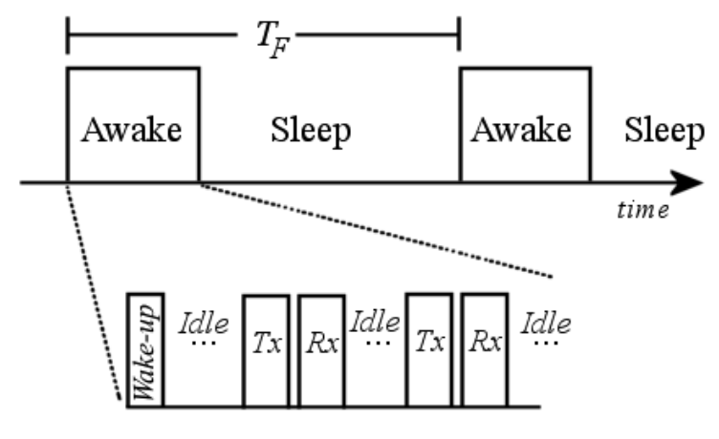
Power Consumption
Radio power consumption critical to consider
Power output level
  Limited savings effect
  Optimal power difficult
  Must be considered globally
Transition times
  Each transition costs
  Power equal to RX mode
  Should be accounted for
v4.3.2010
6LoWPAN: The Wireless Embedded Internet, Shelby & Bormann

Slide 19















Power Consumption
A simple approximation for power consumption:
  = Time that takes to go from sleep state to awake state
  = Transmitter setup time, i.e. time it takes for the transmitter to be ready
  = Time in the Tx state
  = Receiver setup time, i.e. time it takes for the receiver to be ready
  = Time in the Rx state
  = Time in the idle state
  = Time in the sleep state
  = Average number of times per frame that the transmitter is used
  = Average number of times per frame that the receiver is used
  = Duration of the time frame
  = Power used in the Tx state
  = Power used in the Rx state
  = Power used in the idle state
  = Power used in the sleep state
  = Average power used by the transceiver
v4.3.2010
6LoWPAN: The Wireless Embedded Internet, Shelby & Bormann

Slide 20
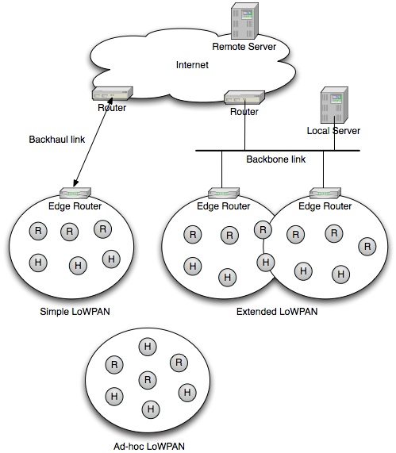

Architecture
v6.12.2009
6LoWPAN: The Wireless Embedded Internet, Shelby & Bormann
Notes:
What software needs to be done?
Node SW (hard real time embedded software)
Edge router SW (embedded linux software development)
Database software development
Web applications
Mastering the whole sensor network development (hardware, embedded SW, network protocols) is challenging.

Slide 21
WSN network architecture
Differences to mobile networks
  Network structure is done in boot.
  No or little support for mobility (IP mobility)
  No charging

Slide 22
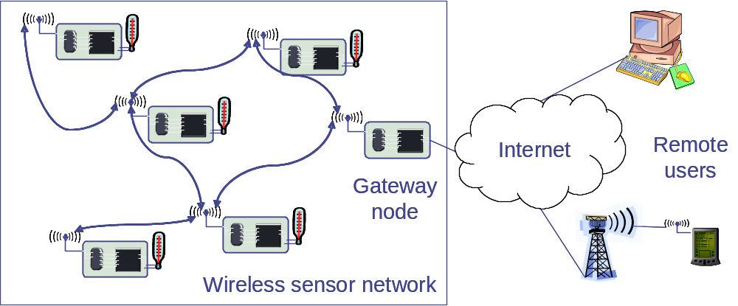
Gateway concepts for WSN/MANET
Gateways are necessary to the Internet for remote access to/from the WSN
  Same is true for ad hoc networks; additional complications due to mobility (change route to the gateway; use different gateways)
  WSN: Additionally bridge the gap between different interaction semantics (data vs. address-centric networking) in the gateway
Gateway needs support for different radios/protocols, …
SS 05
Ad hoc & sensor networs - Ch 3: Network architecture

Slide 23
WSN to Internet communication
Example: Deliver an alarm message to an Internet host
Issues
  Need to find a gateway (integrates routing & service discovery)
  Choose “best” gateway if several are available
  How to find Alice or Alice’s IP?
Alert Alice
Alice‘s desktop
Internet
Gateway
nodes
Alice‘s PDA
SS 05
Ad hoc & sensor networs - Ch 3: Network architecture

Slide 24
Internet to WSN communication
How to find the right WSN to answer a need?
How to translate from IP protocols to WSN protocols, semantics?
Remote requester
Internet
Gateway
nodes
Gateway
SS 05
Ad hoc & sensor networs - Ch 3: Network architecture

Slide 25
Group excercise (2-3 persons) (1-3p)
IEEE 802.15.4 specification supports both beacon and non-beacon modes of operation. What does that mean? Which mode to use?
What can you tell about energy harvesting?
What parts of a sensor node architecture need more developent for low power, low cost sensor nodes to be reality?
If you would need to do the programming of the whole sensor network. What kind of softaware expertise is needed?

Slide 26
Extra excercise
Read zigbee_routing_1,2,3,4 documents.
Explain how route from node A to F is created in the document example.
  How winning route is determined?
  What routing table contains?
  What route discovery table contains?
  How node B knows that A send the route discovery message in the first phase?

